Slide 1


[SOCIAL MEDIA AND CONTENT CREATION]

Slide 2


Today's agenda
Project recap
Problem
The Analytics team
Process
Insights
Summary

Slide 3

ANALYSIS OF THE DIFFERENT DATA
Project Recap

Slide 4

Problem

Slide 5

The Analytics team
T.Sai vasanth kumar

Slide 6
Process
1 Data understanding
2 Data cleaning
3 Adaptability
4 Data analysis
5 Summary

Slide 7

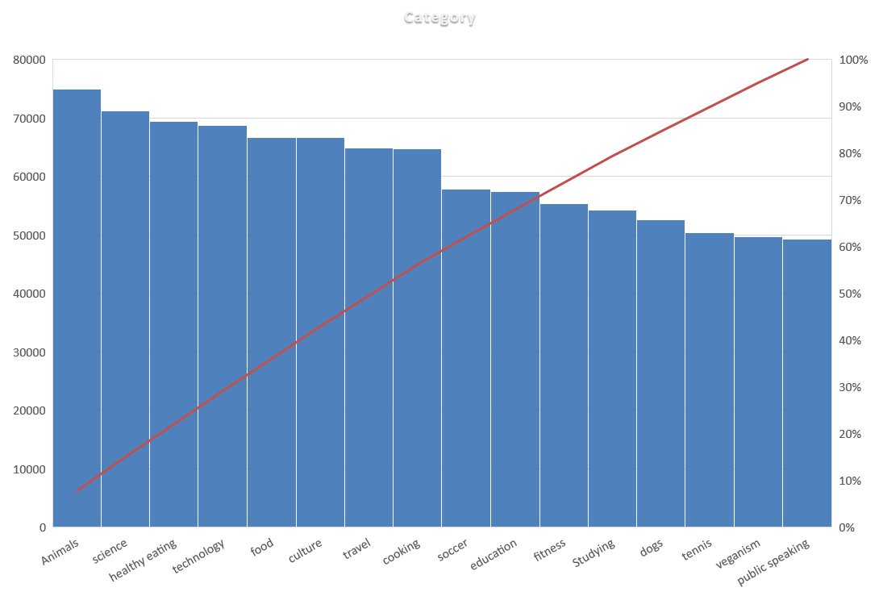
Different type of categories

Slide 9
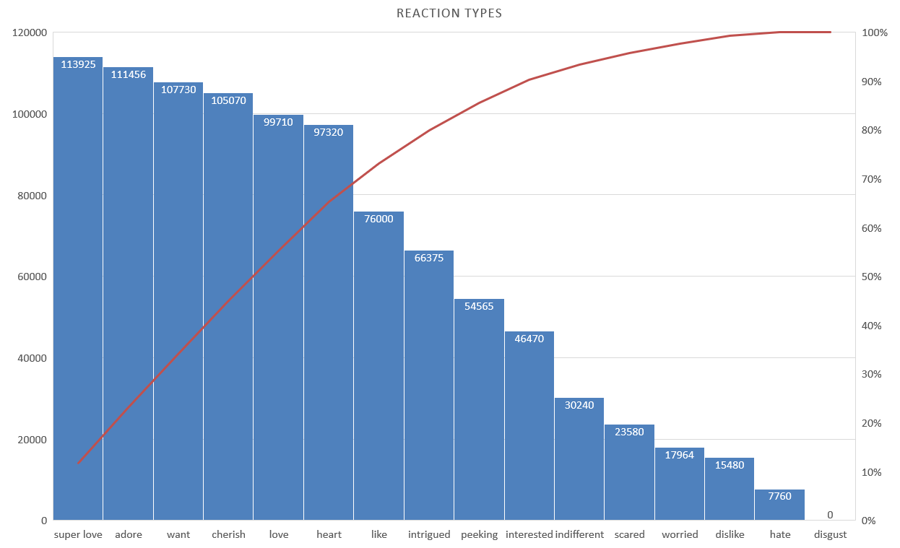

Slide 10
Summary
WE ARE ABLE TO FIND THE VARIOUS KINDS OF DATA USING THE PIE CHART AND BAR CHART
WE USED THE VLOOKUP AND SUMIF FUNCTION FOR MODERATING THE CONTENT
DIFFERENT TYPE OF DATA WERE CLEANED A

Slide 11
Thank you!
ANY QUESTIONS?

